Slide 1
Writing a Final Year Project Report
Project (Technical Computing)

Slide 2
Progress
Who has a book of notes?
What does it contain?
What other techniques are you using to keep a record of your project progress?
Who has written a contents page?
Have you seen the hand-in date for this?
Who has started the project report?

Slide 3
Milestones and deadlines
Blackboard > Module Documents
Different milestones depending on your course
Same summative deadline of 15:00 Thursday 20 April 2023

Slide 4
The project report
Enables the tutors to give you a mark (the deliverable does not - at least not directly).
The report and the deliverable are equally important. You cannot pass the module without doing both elements.
Whether the project has been a success or not, the report can be of good quality.

Slide 5
Where to start?
With the marking scheme
Then
Contents page
What do we look for in a project
TurnitinUK
Formatting
What happens next
Places to go for help
Books
Critical evaluation
Ethics and questionnaires

Slide 6
How long should the report be?
As a guide, the main report should be 8,000 words (± 10%). This does not include code extracts, references, bibliography or appendices.
So approximately how many words should there be in each section?

Slide 7
Words
Words
800
1600
4000
800
400
Words
800
Learning Outcome | How will you demonstrate this? | How will this be assessed? | How much is it worth? | How can I produce high quality work?
Carrying out an in-depth investigation of the context and literature and, where appropriate, other similar products. | Research chapters of your report. | As part of the project report. | 10% | Look at a range of literature types: web, books, papers, conference proceedings etc. Analyse them and discuss your findings as a whole. Investigate similar relevant products, compare them with each other and explore how they relate to your proposal. Provide a complete and thorough analysis of all the relevant dimensions of your project.
Identifying, selecting and applying appropriate tools, techniques and approaches relevant to the project. | Summarise findings in a chapter of your report. | As part of the project report. | 20% | Appraise a variety of relevant approaches (software, hardware, techniques, systems, etc) and clearly justify your selection of the processes chosen to complete your project, showing some originality.
Producing a set of deliverables by which the success of the piece of work can be judged. | Create a deliverable supported by techniques and skills you have learnt during your course. | Described as part of the project report. Give a demonstration of your work. Include a video of your deliverable. | 50% | Produce and present an outstanding deliverable, relating it back to the approaches and processes chosen in the previous section. In the project report, describe the creation of the deliverable, give reasons as to why choices have made a difference to your final deliverable. Relate the success of your deliverable to both the project specification aims and to the users of your work (where appropriate). Measure the success of your project using accepted metrics and relevant techniques. Demonstrate your deliverable to your tutors in a clear and coherent manner. Submit a short but clear video of your deliverable.
Research, critically reflect on and clearly communicate issues relevant to project success. | Write a critical reflection of both the project as a whole and the final deliverable. Discuss further work for your project. | The final chapter in your report - part 1 | 10% | Write an excellent critical analysis, using clear and relevant examples of your work to back up your discussion on the success or otherwise of your project deliverable. You should also discuss the techniques, approaches and processes that were used (and their success or otherwise). In addition, discuss exciting and original ideas for future developments and clearly explain how these may be achieved.
Research, critically reflect on and clearly communicate issues relevant to professional and ethical concerns and aspects of personal development planning (PDP). | Write about the how the project has helped you develop both personally and professionally. Include any ethical issues that have arisen and discuss how they have been resolved. | The final chapter in your report - part 2 | 5% | Provide a convincing discussion of personal and professional learning that has taken place and how this learning will influence your future direction. This should also include personal development that has taken place, with examples to back up your discussion wherever possible. Where appropriate, clearly and convincingly discuss how ethical and professional issues have influenced decisions taken throughout the project.
Quality of report and referencing. | Have an error-free report with a wide range of references. | Make sure your whole report is well referenced and error free. | 5% | Spend time making the report error-free, good looking and a pleasure to read. Make sure you have a wide range of references, not just website references, all correctly cited.
See BB for full marking scheme

Slide 8
50% of the marks is for the deliverable
The feedback sheet says the assessment criteria are:
Producing a set of deliverables by which the success of the piece of work can be judged.
Marking should address the following:
Does the deliverable meet the aims of the project and the target audience?
Were suitable and relevant engineering approaches/processes used?
Has the success of the project been measured?
What is the quality of the deliverable and its video?
What is the difficulty of the deliverable?
How complete is the deliverable?
Is it well described in the documentation?
Was the demonstration of the work convincing?
So cover these areas in your report.

Slide 9
Contents Page
The contents should tell the story of both the marking scheme and the project.
Introduction . . . . . . . . . . .
Investigation/Research . . . .
Selection/Planning/Design . .
Development/Production/Doing/Testing
Critical Reflection/Evaluation (of both the project deliverable and your performance)
Conclusion
Assessment Criteria
Carrying out an in-depth investigation of the context and literature and, where appropriate, other similar products. (10%)
Identifying, selecting and applying appropriate tools, techniques and approaches relevant to the project. (20%)
Producing a set of deliverables by which the success of the piece of work can be judged. Marking should address the following: Does the deliverable meet the aims of the project and the target audience? Were suitable and relevant engineering approaches/processes used? Has the success of the project been measured? What is the quality of the deliverable and its video? What is the difficulty of the deliverable? How complete is the deliverable? Is it well described in the documentation? Was the demonstration of the work convincing? (50%)
Research, critically reflect on and clearly communicate issues relevant to project success. (10%)
Research, critically reflect on and clearly communicate issues relevant to professional and ethical concerns, risk, and aspects of personal development planning (PDP). (5%)
Quality of report and referencing. (5%)

Slide 10
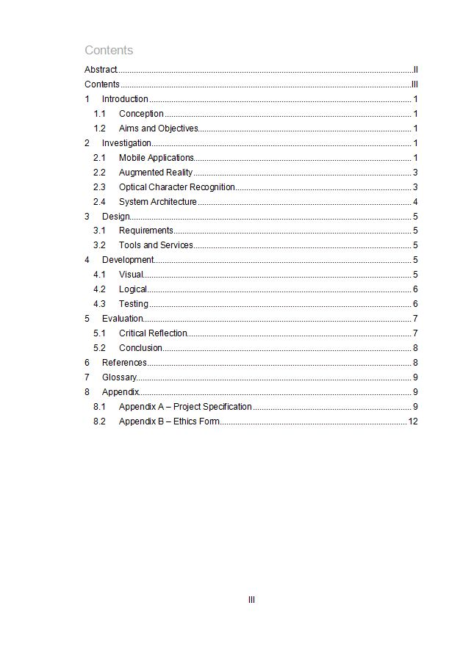
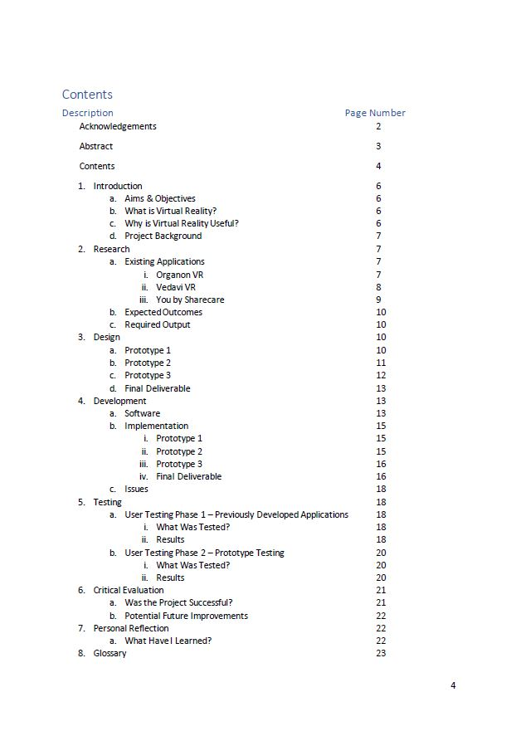
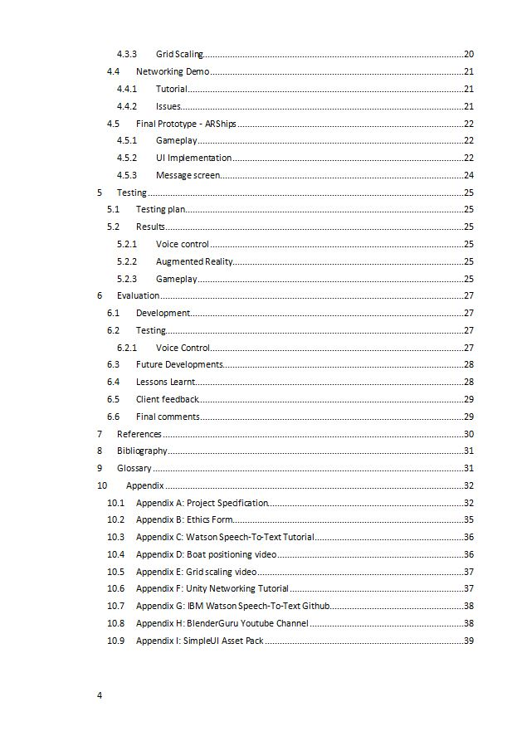
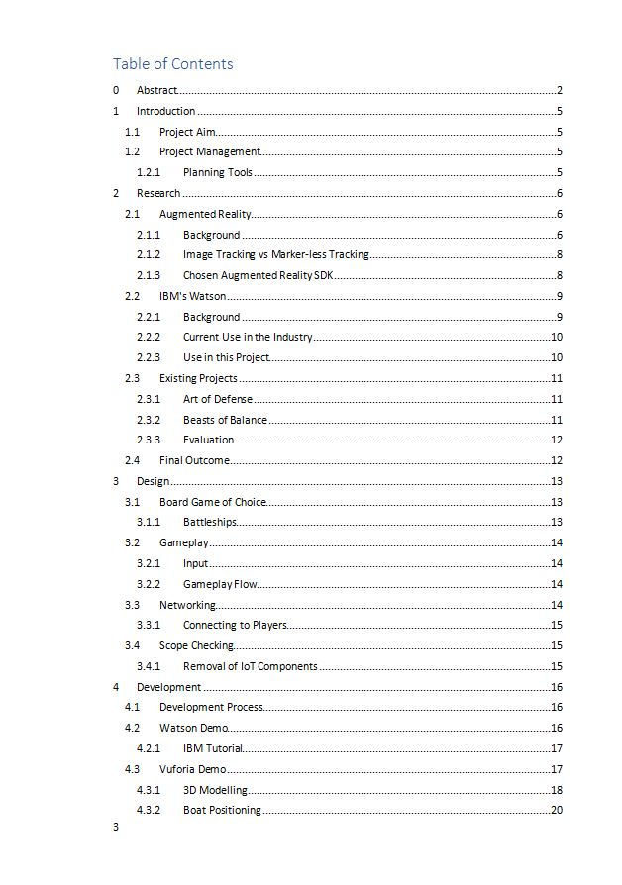
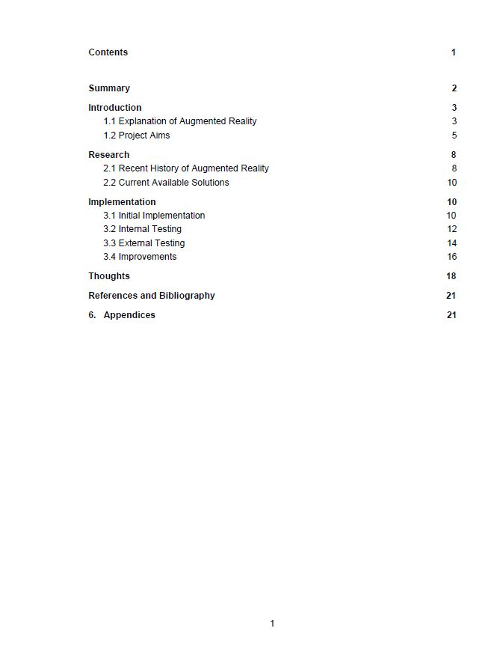

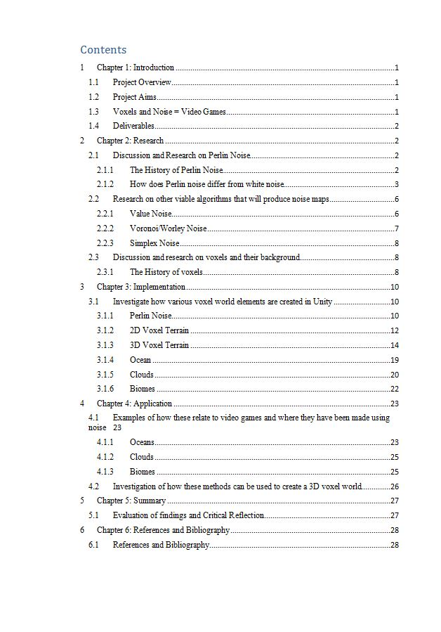
Examples of Contents Pages

Slide 11
What are we looking for in a project report?
The extent to which the learning outcomes have been achieved (look on BB for the module descriptor and marking scheme).
We don't look for 'right' answers. We look for a critical, justified, evidenced, coherent evaluation of the project, its process and deliverables.
We look for evidence that you have learnt a lot and applied it. If this has happened then the project report writing is straight forward.

Slide 12
When to start using Turnitin
The report is around 80% complete
There is enough time for feedback from your supervisor
All sections should be there, but may not all be finished
Check the similarity score and discuss with your supervisor if necessary.
The PRACTICE TURNITIN AREA is already available on BB.

Slide 13
To think about
Your supervisor often has a good idea about what mark you will get for your project. Who are you really writing the report for?
Make it interesting to read.
Give it a beginning, a middle and an end - like a book.

Slide 14
What do I have to hand in?
report (but NOT appendices) to Turnitin (via BB) the complete and final report (with appendices) (to BB) a video demonstrating the deliverable (to BB) your deliverable uploaded to either BB (file size restrictions) or to the Q:\ drive (StudentSharedDrive) which has no file size restriction. Accessed through https://myfiles.shu.ac.uk/htcomnet/.

Slide 15
From the Handbook . . .
Layout of the project report
Front cover (title page) should use the pro-forma provided (Appendix E) and give your name, the date, your supervisor's name, your course and the project title. If appropriate, this should include a statement stating that the dissertation is confidential. Otherwise, you should say yes to giving permission for next year’s students to see your work.
Acknowledgements to individuals or organisations that have assisted you in the project. This is optional and should be on a separate page.
An abstract or synopsis not exceeding 300 words on one side of A4 providing a summary of the report stating the nature and scope of the work undertaken and a summary of findings. The synopsis should communicate the essence of the dissertation and answer the question “in a nutshell, what is the whole thing about?” It should be possible to read the abstract on its own.
Contents page showing chapters and page numbers.
Main body of the dissertation: Introductory chapter(s) Design, development and evaluation chapters Concluding chapter(s)
References and bibliography The list of references should contain all the items that you have explicitly referred to in the report. The bibliography should contain any additional source material not specifically referred to in the text but that you have used and which may provide supporting information.
Appendices Appendix A – Project Specification document Appendix B – The Ethics form Appendix n - Listing, screen dumps, graphs, tables, interview data, observation records, organisational documentation, etc.

Slide 16
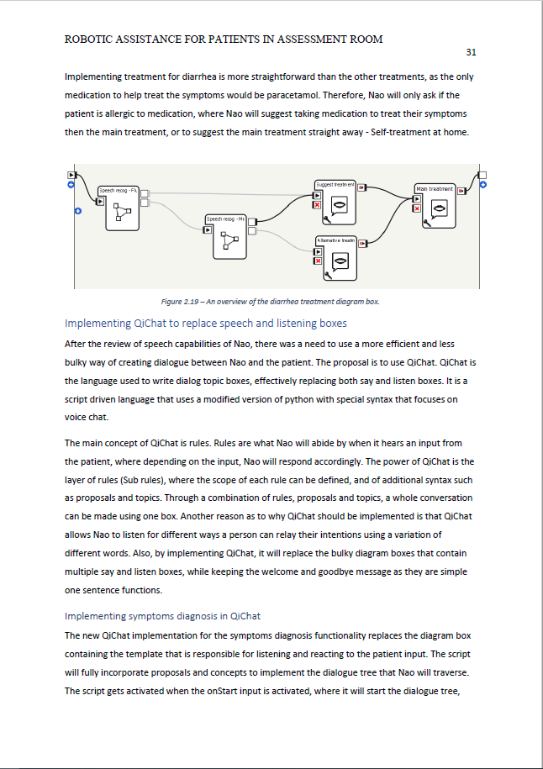
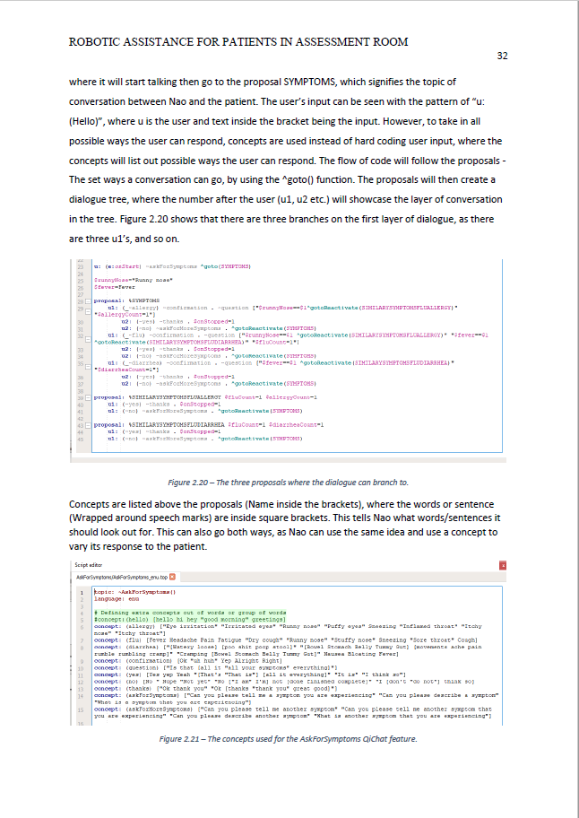
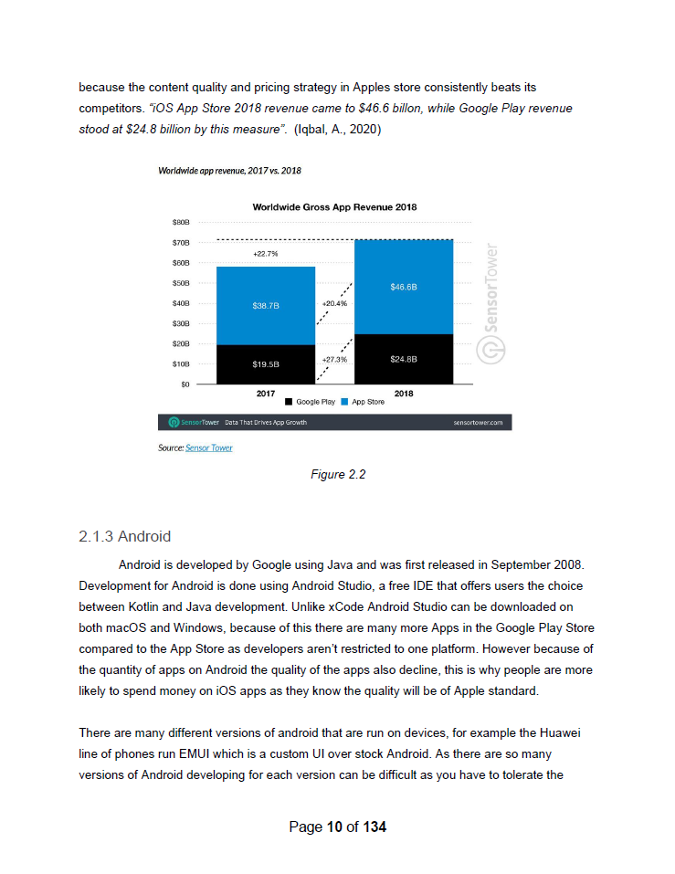
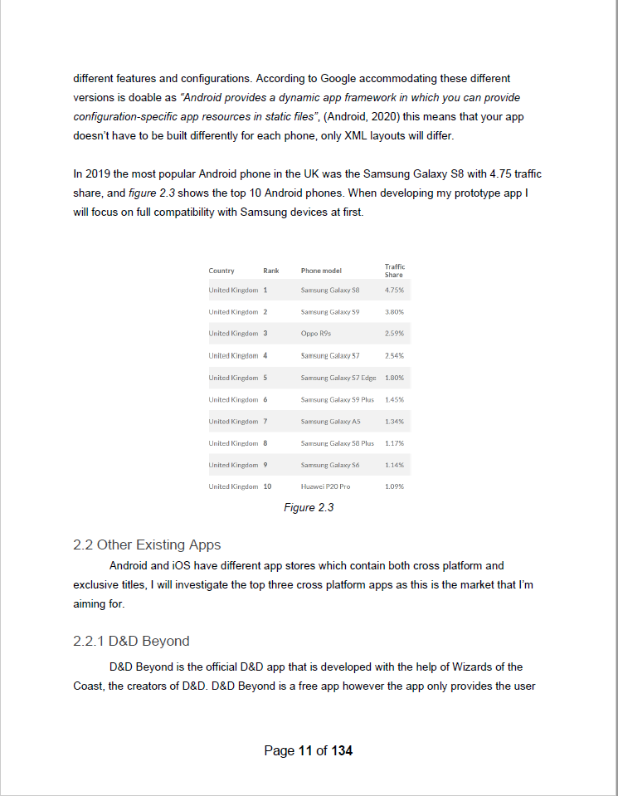
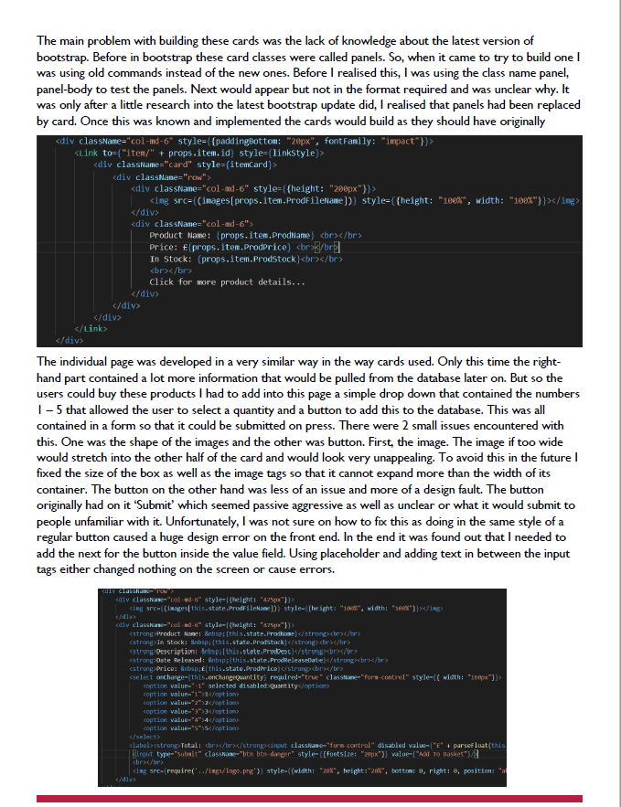
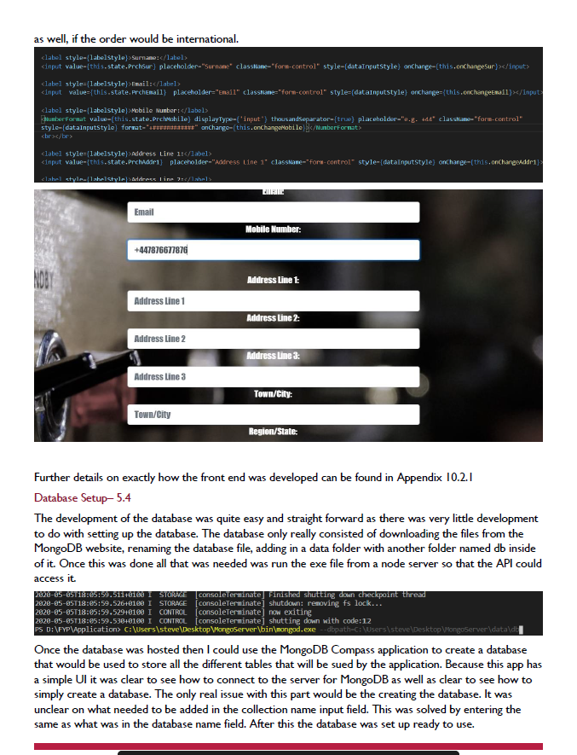
Report Layout Examples

Slide 17
What happens after you have handed in your report?
Both your supervisor and your second marker mark the report independently then meet up to discuss and agree the mark.
There will be further scrutiny by a third party to ensure consistency across the different courses and awards and to sort out any projects where the marker and second marker cannot agree.
The result of your project is disclosed as soon as possible. Sorry to be vague. There are a lot of people involved in this.
Feedback on your project will be made available via BB alongside your marks.
If you fail the project module you will be given feedback and a re-submission date. Your subsequent mark will normally be capped at 40%.

Slide 18

Places to go for help
Project supervisor
MyHallam or Library from within Bb.
Academic skills (via 'the Skills Centre', )
Studiosity
Finding and using library resources
Help with Referencing
Writing
Contact Simon Quinn (s.c.quinn@shu.ac.uk) if you need help with the library systems.
General IT help ithelp@shu.ac.uk
Module leader
Student support
Friends and family

Slide 19
Books
Greetham, B. (2014). How to write your undergraduate dissertation (2nd ed). Basingstoke : Palgrave Macmillan.
and others . . . . . . . .
Referencing - APA Harvard style (http://libguides.shu.ac.uk/referencing)

Slide 20
Hints and Tips
Use the third person ("it was noted that ... " not "I noted that ....")
Proof read and profo read again and get someone else to pfoor read it as well.
Use plenty of images.
Leave plenty of white space.
Use Turnitin as soon as you can - this facility is already available to you on BB.
Don't leave it until the last minute - it takes longer than you can imagine to produce a professional polished document.
Back up your work.
Look at the examples on BB.

Slide 21
Critical Reflection and Evaluation

Slide 22
Progress
Who has done (or is going to do) testing?
What does it involve?
Who has received feedback (or is going to receive feedback) on their deliverable?
What are you going to do with it?

Slide 23
The Project Report
Enables the tutors to give you a mark (the deliverable does not - at least not directly).
Whether the project has been a success or not, the report can be of good quality.
and so can the 15% critical analysis

Slide 24
What is critical reflection, evaluation, analysis?
Critical (from http://dictionary.cambridge.org/)
critical adjective
giving opinions or judgments on books, plays, films, etc.:
Reflection (from http://dictionary.cambridge.org/)
reflection noun (THOUGHT)
serious and careful thought : On reflection (= after considering it), I decided I had been wrong. After 30 years as a judge, her reflections on/about justice were well worth listening to.
Evaluation (from http://dictionary.cambridge.org/)
evaluate verb
to judge or calculate the quality, importance, amount, or value of something: It's impossible to evaluate these results without knowing more about the research methods employed.
Analysis (from http://dictionary.cambridge.org/)
analyse verb
to study or examine something in detail, in order to discover more about it:

Slide 25
What makes for a good critical evaluation?
The final deliverable does everything I set out to do.
I think I did a really good job.
I think I did a really good job, however if I had the time again there are some things I would change such as . . . . . .
The final deliverable does everything I set out to do, however with hindsight it is obvious that there are other possible solutions . . .
All the aims of the project are met.
The client was very pleased with the end result.
The client was very pleased with the end result but had the following feedback. . . .
The deliverable meets most of the aims of the project however . . . . .

Slide 26
Which questions should it answer?
What?
When ?
Who?
Where?
Why?
How?

Slide 27
Research, critically reflect on and clearly communicate issues relevant to project success. | Write a critical reflection of both the project as a whole and the final deliverable. Discuss further work for your project. | The final chapter in your report - part 1 | 10% | Write an excellent critical analysis, using clear and relevant examples of your work to back up your discussion on the success or otherwise of your project deliverable. You should also discuss the techniques, approaches and processes that were used (and their success or otherwise). In addition, discuss exciting and original ideas for future developments and clearly explain how these may be achieved.
Case Study
You have created an android app to teach young children (age 3 and under) shapes and colours. The app uses image recognition to see if the object brought to the phone's camera is of the correct shape or colour.
The project has gone OK although you had problems with getting the colour recognition working accurately.
You also could not go into the nursery as you hoped in order to test your application. Nursery staff you have shown the app to have responded favourably.
There was that moment when you realised that the software you were using was not going to allow you to do what you wanted to do and you were going to have to code the app from first principles.
The app can only be run in test (simulation) mode as you did not get round to publishing it.

Slide 28
Research, critically reflect on and clearly communicate issues relevant to professional and ethical concerns and aspects of personal development planning (PDP). | Write about the how the project has helped you develop both personally and professionally. Include any ethical issues that have arisen and discuss how they have been resolved. | The final chapter in your report - part 2 | 5% | Provide a convincing discussion of personal and professional learning that has taken place and how this learning will influence your future direction. This should also include personal development that has taken place, with examples to back up your discussion wherever possible. Where appropriate, clearly and convincingly discuss how ethical and professional issues have influenced decisions taken throughout the project.
Case Study
You have created an android app to teach young children (age 3 and under) shapes and colours. The app uses image recognition to see if the object brought to the phone's camera is of the correct shape or colour.
You had moments of real stress when you felt like you had so many other deadlines that you couldn't do what you wanted to do on the project. And you are disappointed that you allowed the other assignments to get in the way of moving forward with your project work.
You had to work out what to do about your project when you were not allowed to go into the nursery for product testing.
There was that time when you realised that the software you were using was not going to allow you to do what you wanted to do and you were going to have to code it from first principles.

Slide 29
Final Advice
Don't write, "Due to unforeseen circumstances . . . ."
Don't blame others.
Look at what you could have done to avoid the situation. Only you know how you can change. You cannot ask others to change.
Be positive.
If your time keeping was poor, discuss what you have learnt from it.
If your deliverable was poor, discuss what you would do next time to make it better (i.e. what you have learnt from doing it badly).
Discuss alternatives.
Has it been exhaustively tested?
Unlikely.
Be realistic about the scope of your studies.
Is it ground-breaking?
Unlikely.
Provide evidence and examples to back up your points.
Does the critical evaluation preparation lead you to the point where you need to change the wording or challenge of your project?
Discuss how your project has helped you decide where you want to go in the future (or don't want to go).

Slide 30
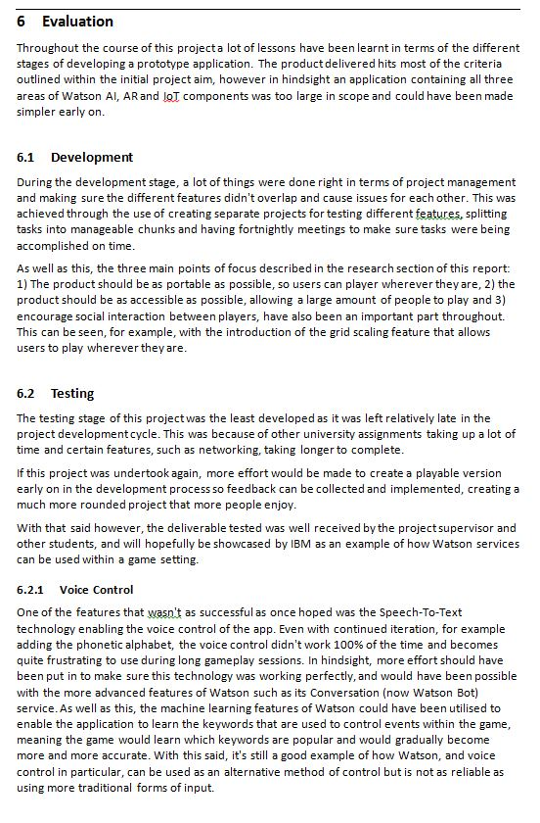
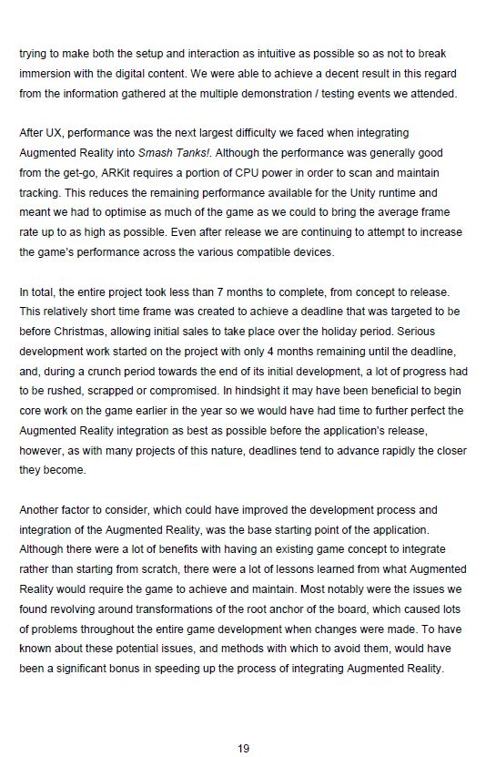

Slide 31
Ethics and Questionnaires/Surveys
You filled in a UREC form as part of your very first submission.
You created a first attempt at the survey/questionnaire you would use.
You wrote a Participant Information Sheet
Revisit it.

Slide 32
University Guidance
The preferred platform for hosting online questionnaires is Qualtrics. Staff and students can request this software from the IT service desk by following this link https://students.shu.ac.uk/shuspacecontent/it/get-help-it, pressing the ‘Submit a support request online’ button, then selecting ‘software’ under the ‘Request a Service – Staff or Student options.
Please ensure that all data downloaded from Qualtrics is stored securely. ... Students on taught courses can store data on their University network drives, but should password protect their files.

Slide 33
University Guidance
Online questionnaire ethics requirements
Provide an initial page before the online questionnaire starts, which contains: (i) a short summary of the project, (ii) key information from the participant information sheet, (iii) the researcher’s contact details, and (iv) a link to a downloadable participant information sheet (PIS). A link to a downloadable PIS is important so that participants are given the legally required information on GDPR/data protection in a form that they can retain.
Provide a final page containing a ‘Submit’ button, prefaced by a statement reminding the participant that clicking the final ‘Submit’ button of the survey at the end will constitute them providing consent to participate, in full knowledge of the information in the participant information sheet.

Slide 34
University Guidance
Suggested content to include on the landing page of your online questionnaire
You are being invited to participate in a research study titled [project title]. This study is being done by [researcher name] from the [School/Department name] at Sheffield Hallam University.
Provide the following key information from the PIS: (i) the aim of the project, (ii) a brief description of what the participant will be asked to do, and (iii) how long it will take to complete the questionnaire. If there is a payment associated with participation, provide details.
If you are interested in taking part, please download a copy of the participant information sheet here [provide download link] and retain this for your records before starting the questionnaire. If you have any questions, please email [XXXXX] at [researcher’s University email address].
Your participation is entirely voluntary, and you can withdraw from the survey by closing your web browser and your data will be deleted from the study. You are free to omit any question. [Make sure your survey/questionnaire allows for the omission of questions].
[If data is collected anonymously] Please note that after you have pressed the submit button at the end of the questionnaire you will no longer be able to able to withdraw from the study. This is because your data will be collected anonymously, and we will not be able to connect you to your answers.
[Start button]
By clicking the ‘Submit’ button below, you are consenting to participate in this study, as it is described in the participant information sheet, which you can download here [provide download link]. If you did not yet download and keep a copy of this document for your records, we recommend you do that now.
[Submit button]

